Slide 1



SMART HOUSE AUTOMATION
Presented by Group 3​

Slide 2
MEMBER OF GROUP
NGÔ XUÂN SƠN - SE170429
HUỲNH NGHIÊM NHẬT HUY - SE170320
NGUYỄN MINH KHÔI NGUYÊN - SE170356
NGUYỄN MINH THÀNH - SE170331

Slide 3
INTRODUCTION
1

Slide 4
INTRODUCTION
In an era marked by a burgeoning reliance on the Internet of Things (IoT) and a growing need for enhanced security, this project represents a significant contribution to the field of smart home and property protection.​
The necessity for the design and development of an innovative Integrated Anti-Theft IoT Door Lock model, featuring sound sensors and a temperature sensor arises from the escalating concerns related to security breaches, unauthorized access, and property safety. Traditional door locks, while time-tested, often fall short of providing comprehensive and proactive security measures. In response to these limitations, this project introduces a cutting-edge solution that leverages IoT technology to deliver real-time monitoring, alerting, and advanced security features.​
The incorporation of sound sensors empowers the system to detect suspicious entry attempts, break-ins, or tampering with the door, ensuring a rapid response to potential threats. Simultaneously, the temperature sensor offers an additional layer of security by identifying hazardous conditions, such as someone attempting to tamper with the door or the presence of a potential intruder.​
With home and property security being a top priority, this project is a valuable initiative, addressing the demand for intelligent, interconnected, and adaptive security systems. This report will delve into the device's functionality, and its potential applications, and underline its significance in the modern security landscape, ultimately contributing to safer and smarter living spaces.​

Slide 5
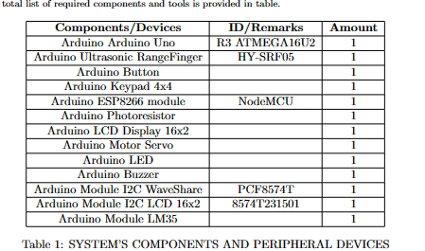
Methods and materials​
2

Slide 6
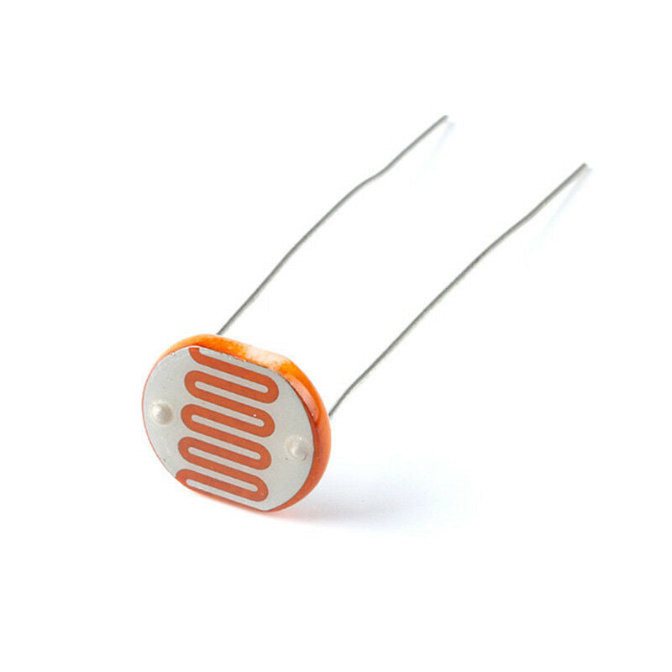
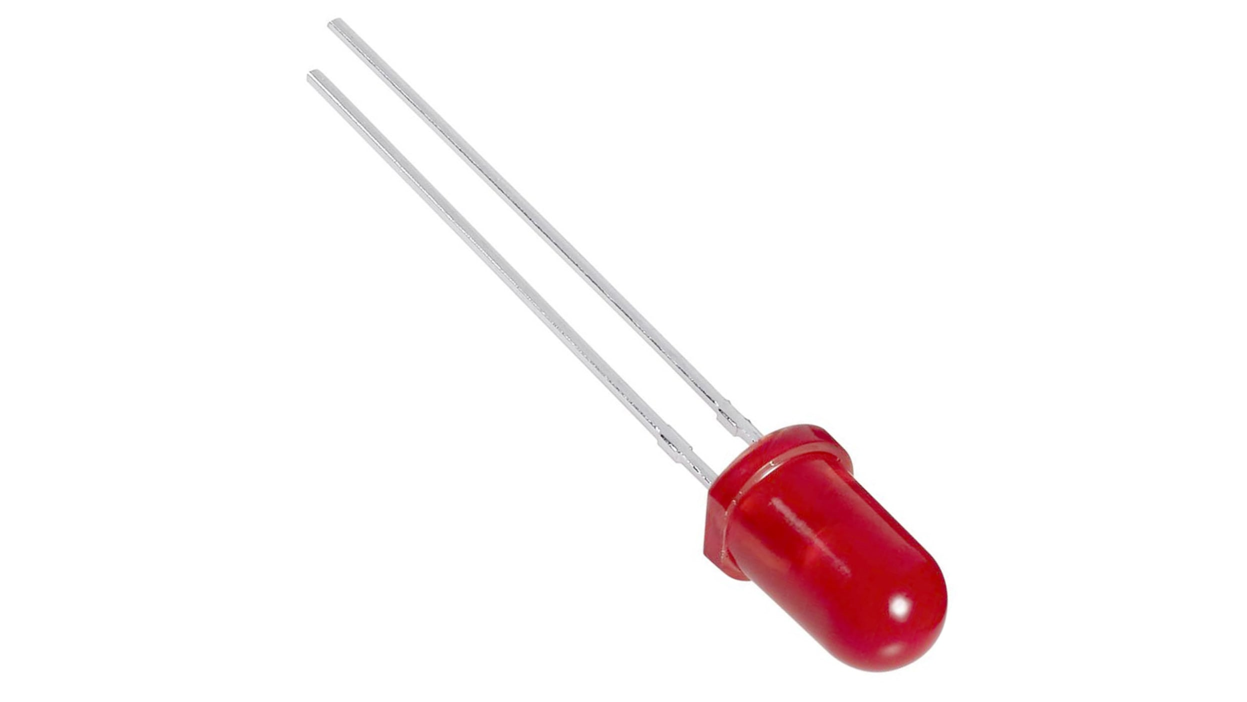
Components and peripheral devices​ ​​ ​
Photoresistor: Used to sense brightness and darkness. And from there adjust the lights accordingly
LED: used for lighting

Slide 7
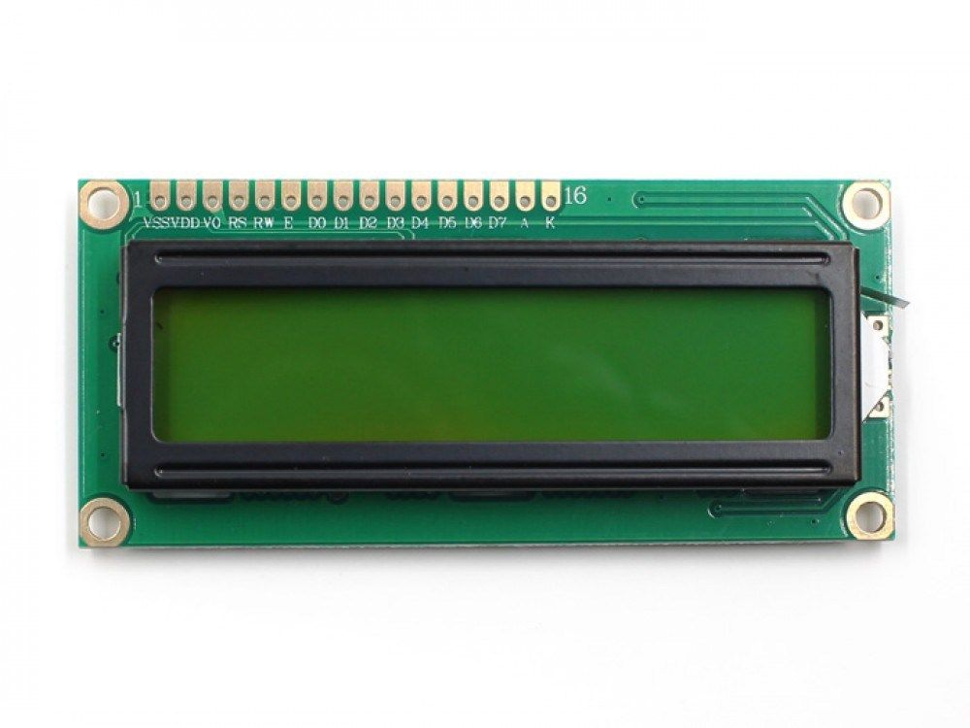
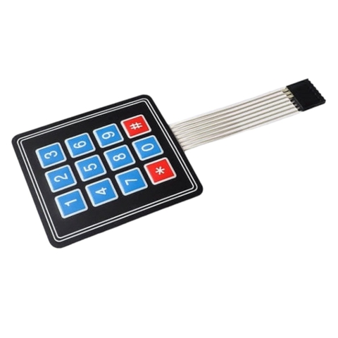
Components and peripheral devices​ ​
LCD Display: It helps to display the password the user entered and show notifications
Keypad: enter the password to open the door. ​

Slide 8
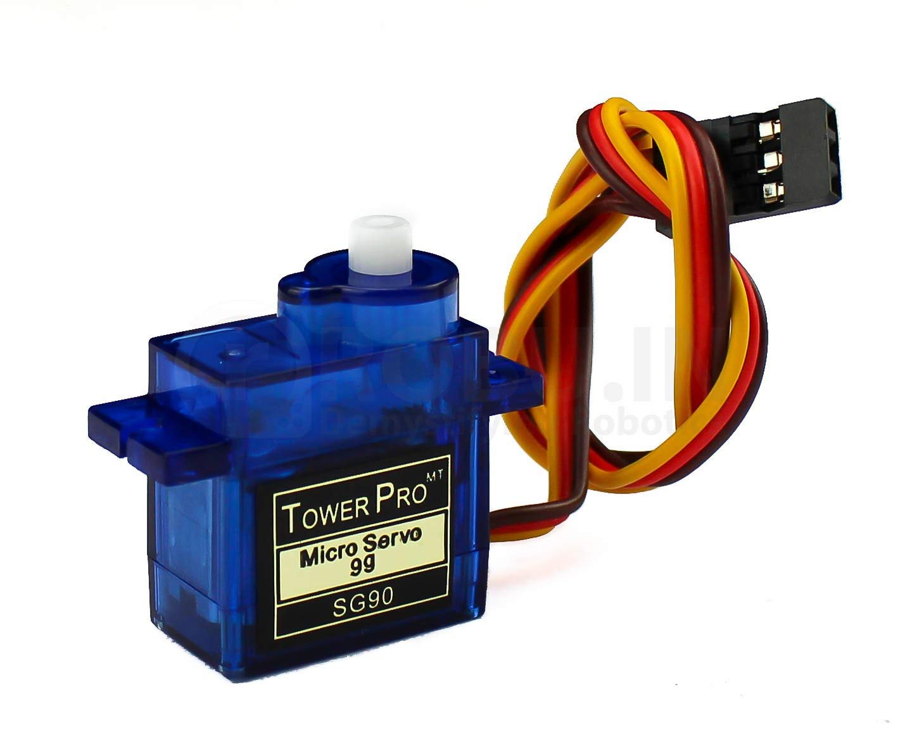
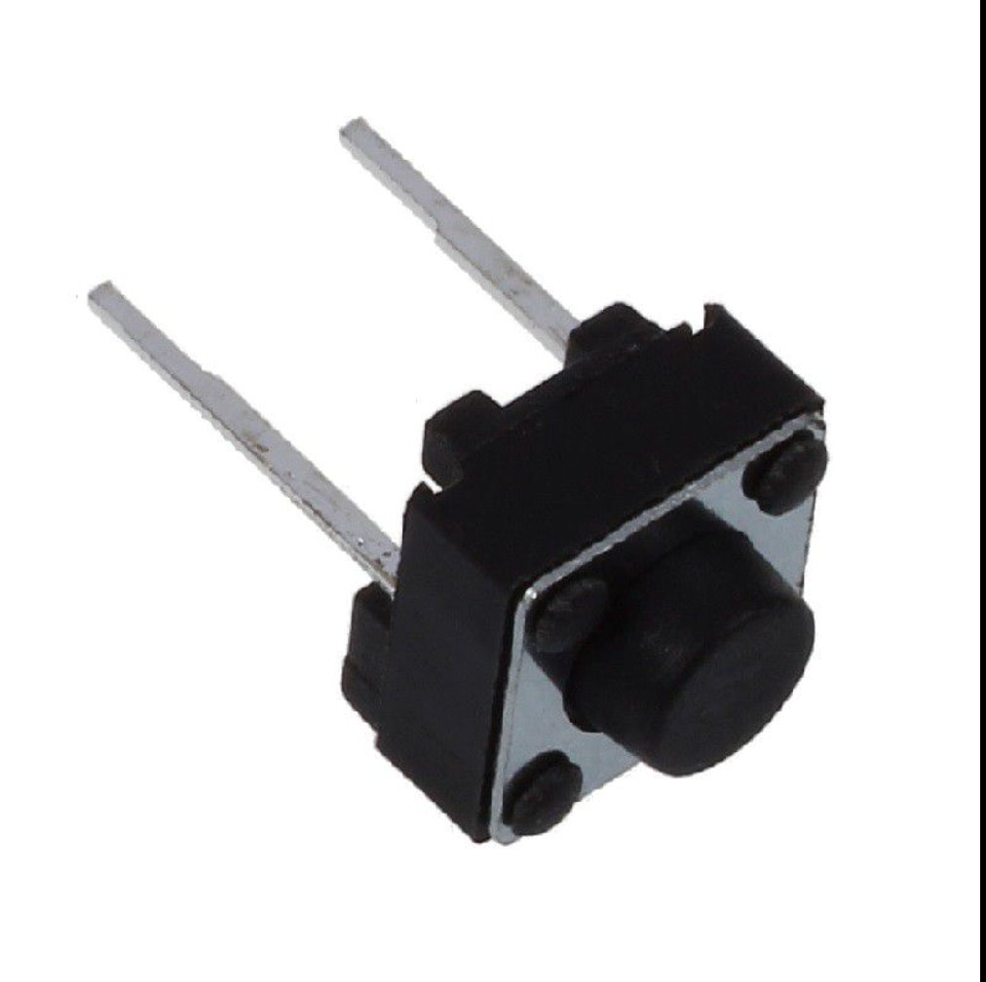
Components and peripheral devices​ ​
Motor Servo: Used to open and close doors
Button: You can click button to open the door

Slide 9
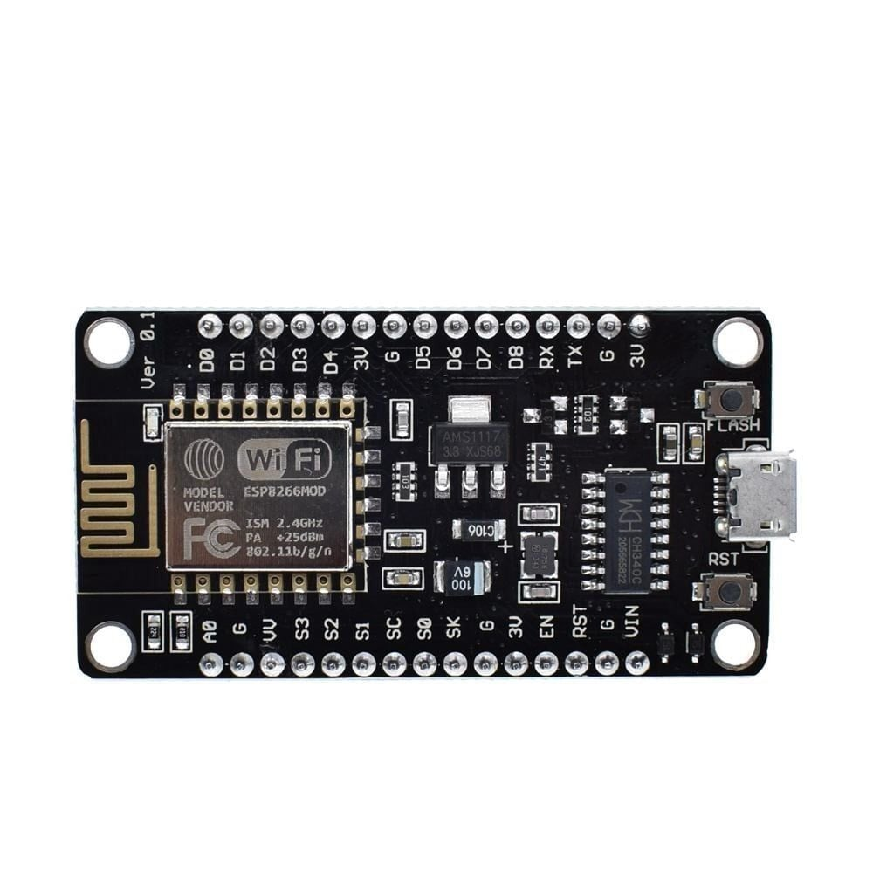
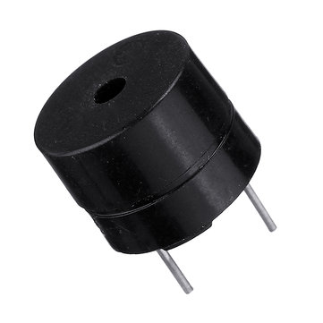
Components and peripheral devices​ ​
ESP8266: Connect devide to internet
Buzzer: Make a sound enter an incorrect password​

Slide 10
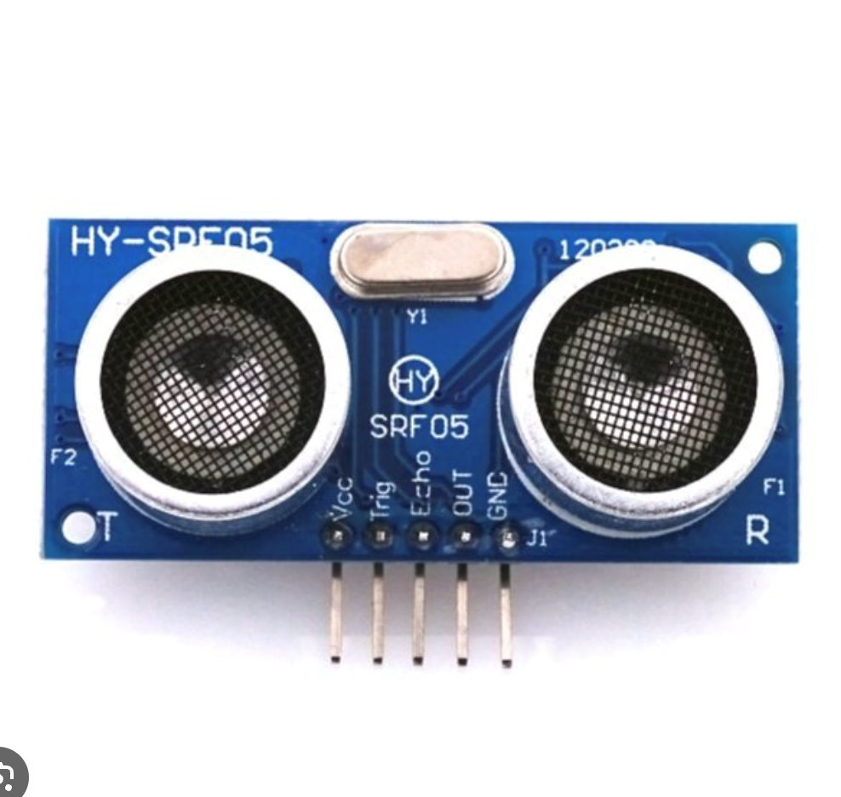
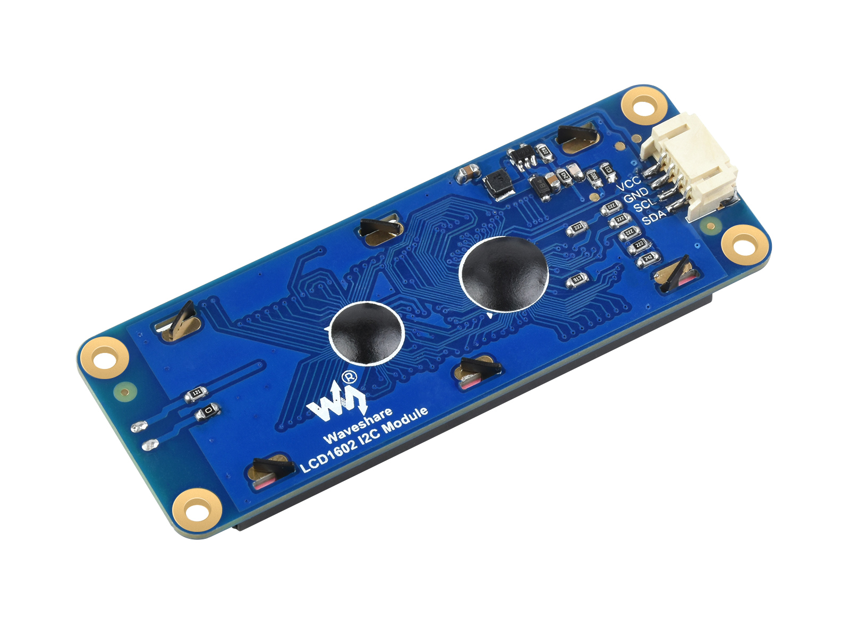
Components and peripheral devices​ ​
Ultrasonic: It will help determine if someone is nearby and wants to enter a password. ​
Module I2C LCD: Connect witch LCD easily and conveniently

Slide 11
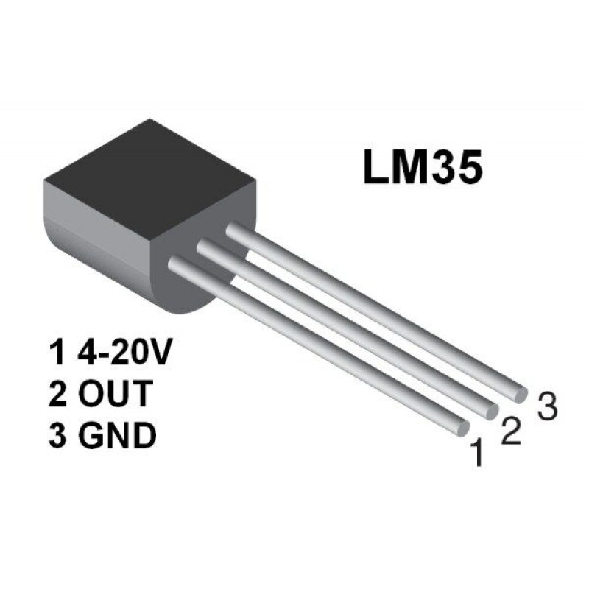
Components and peripheral devices​ ​
The LM35 module is a flexible and precise temperature sensor

Slide 12
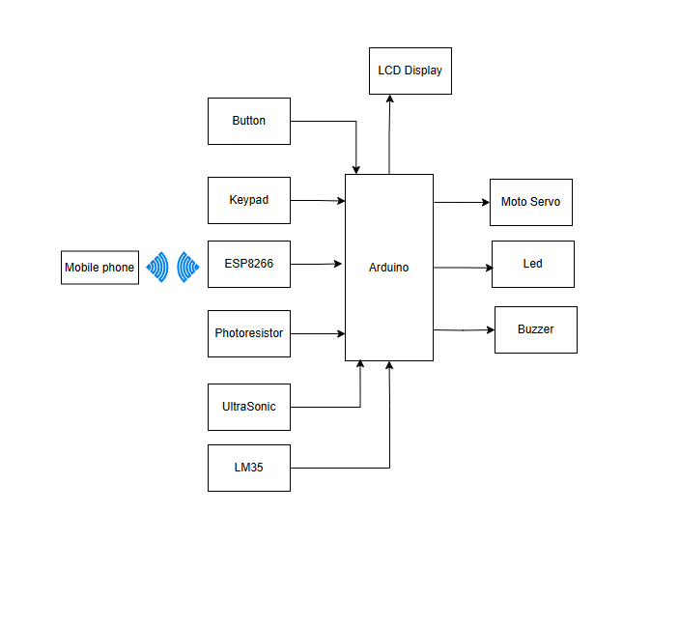
System Model and Block Diagram

Slide 13
Electronic Circuit/Hardware Interfacing​
Arduino Uno R3 is used to make decisions such as opening doors, changing passwords, changing cards and sending results based on data from sensors. shows the circuit communication diagram of the developed device, where the sound sensor and light sensor are communicated with Arduino via D7, D8 and A0, respectively, the Keypad and LCD display are Controlled by SDA and SCL, these two devices are connected to each other and connected to Arduino using I2C. The Bluetooth module is connected to D2 and D3. The RFID module is connected to the Arduino through ports D9 to D13.

Slide 14
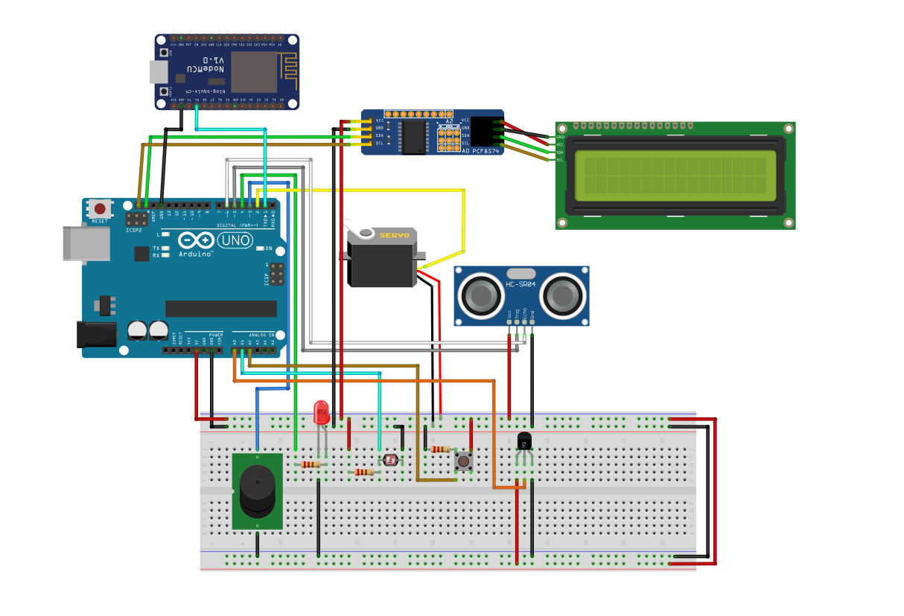
Electronic Circuit/Hardware Interfacing​

Slide 15
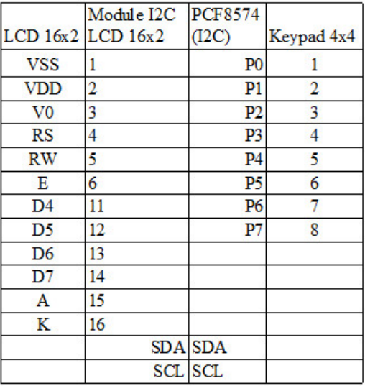
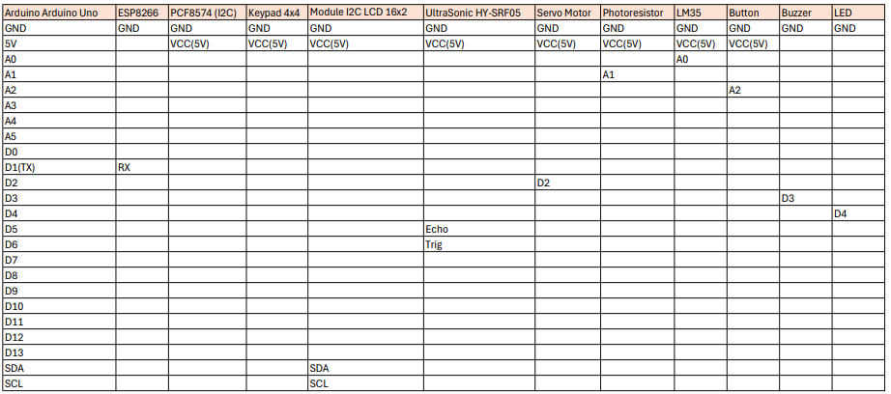
Electronic Circuit/Hardware Interfacing​
Interfacing between Arduino Uno and its components (pin-to-pin)

Slide 16
Software Programming​
3

Slide 17
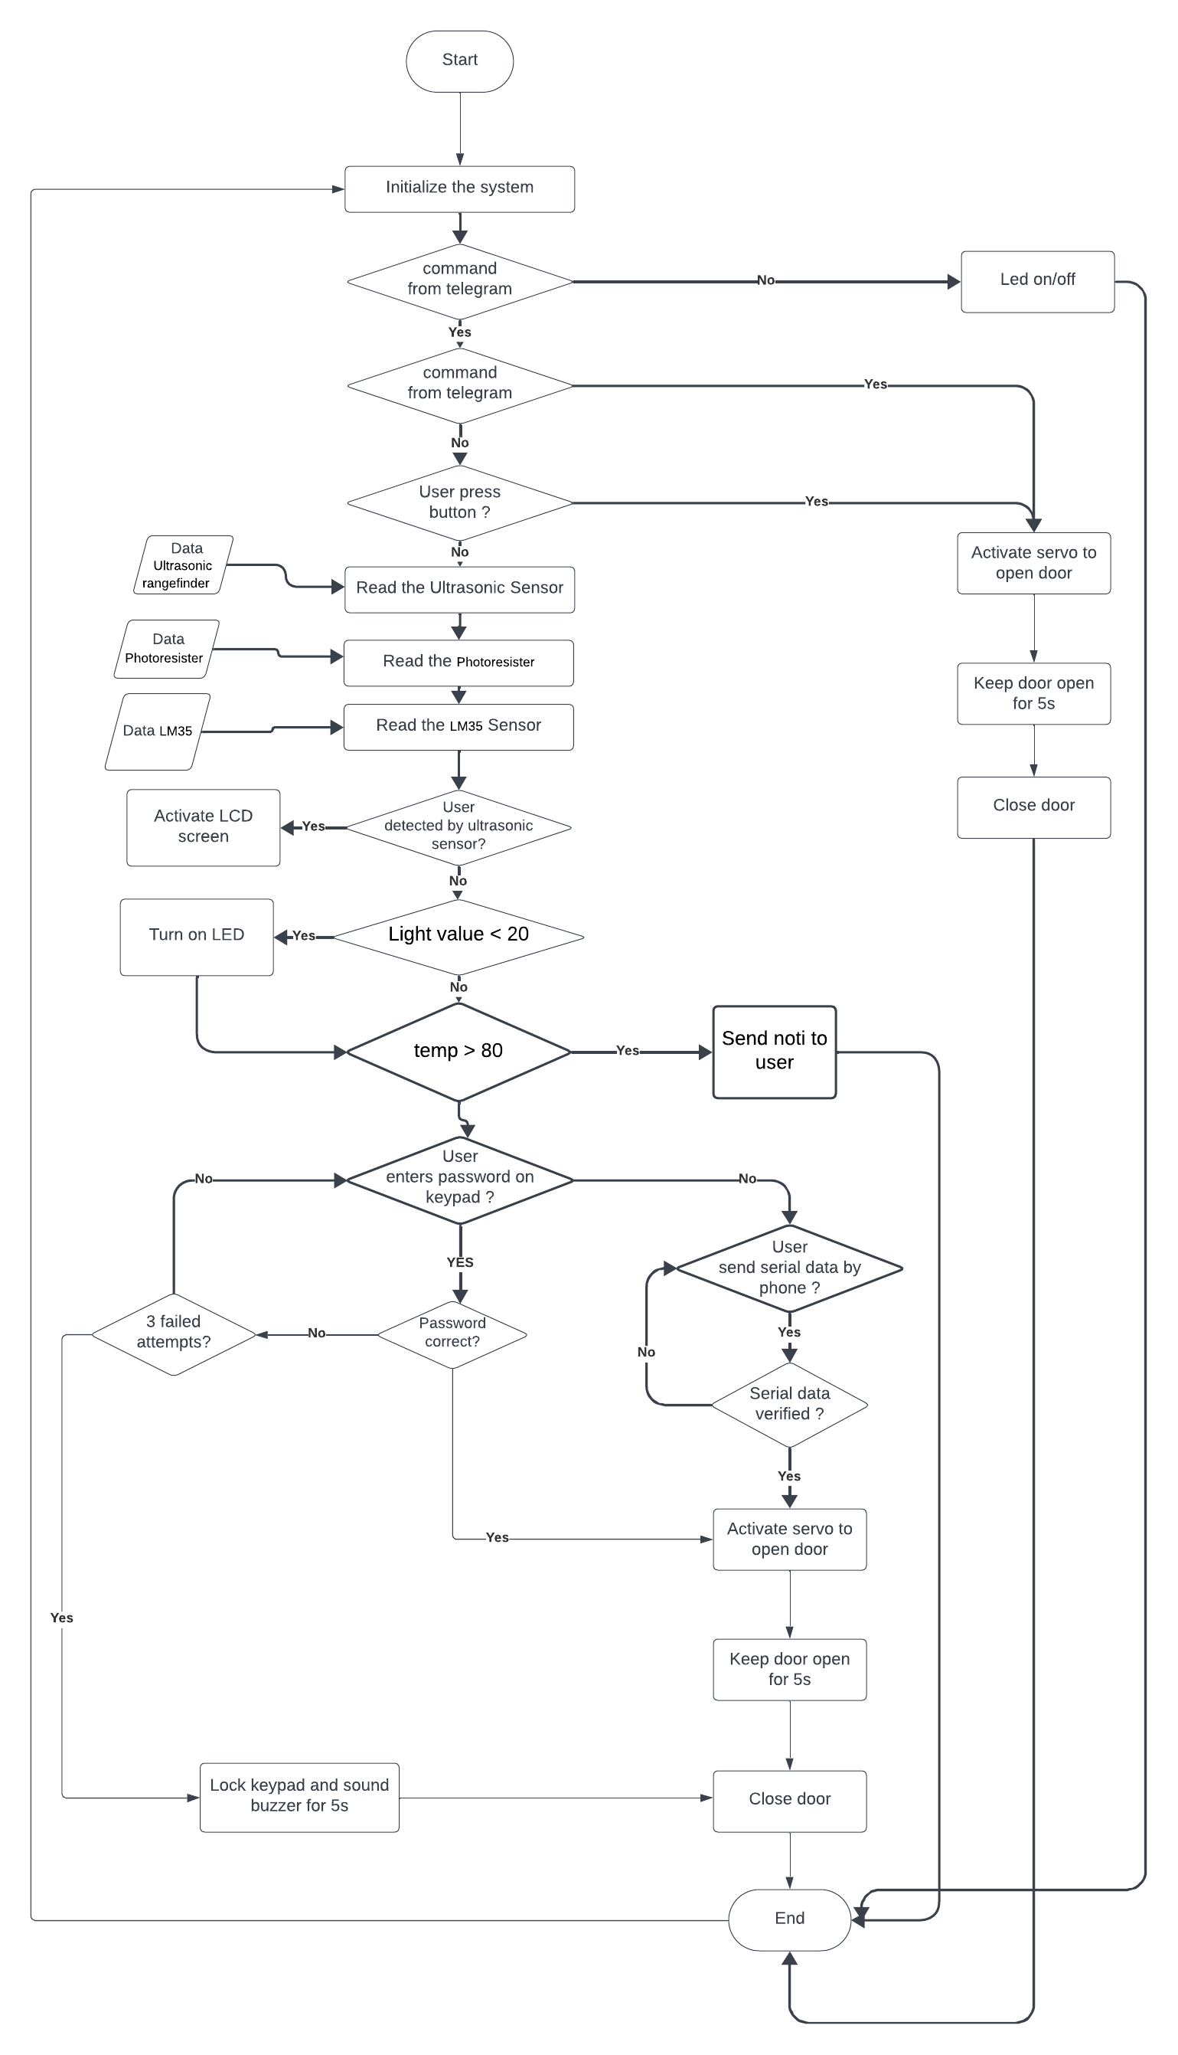
FlowChart

Slide 18
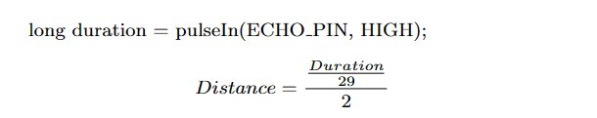
Sensors and Parameter Setup​

Slide 19
Results from Prototype Testing​ ​
To test this system, you need to mount it on a door. After that, the system will running based to the above principles and connections. Open the door with Keypad, RFID Card/Tag or Bluetooth by a phone. The LCD will display the password entered and notifications about success or falied. It also send this notifications to the phone.​

Slide 20
Results and discussion​
4

Slide 21
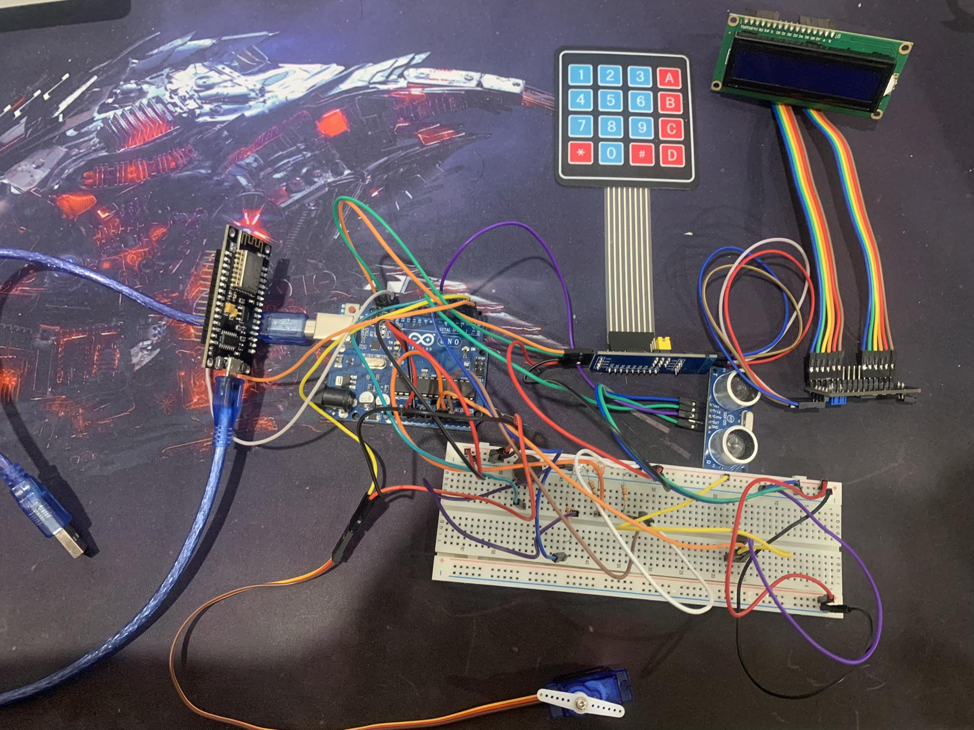
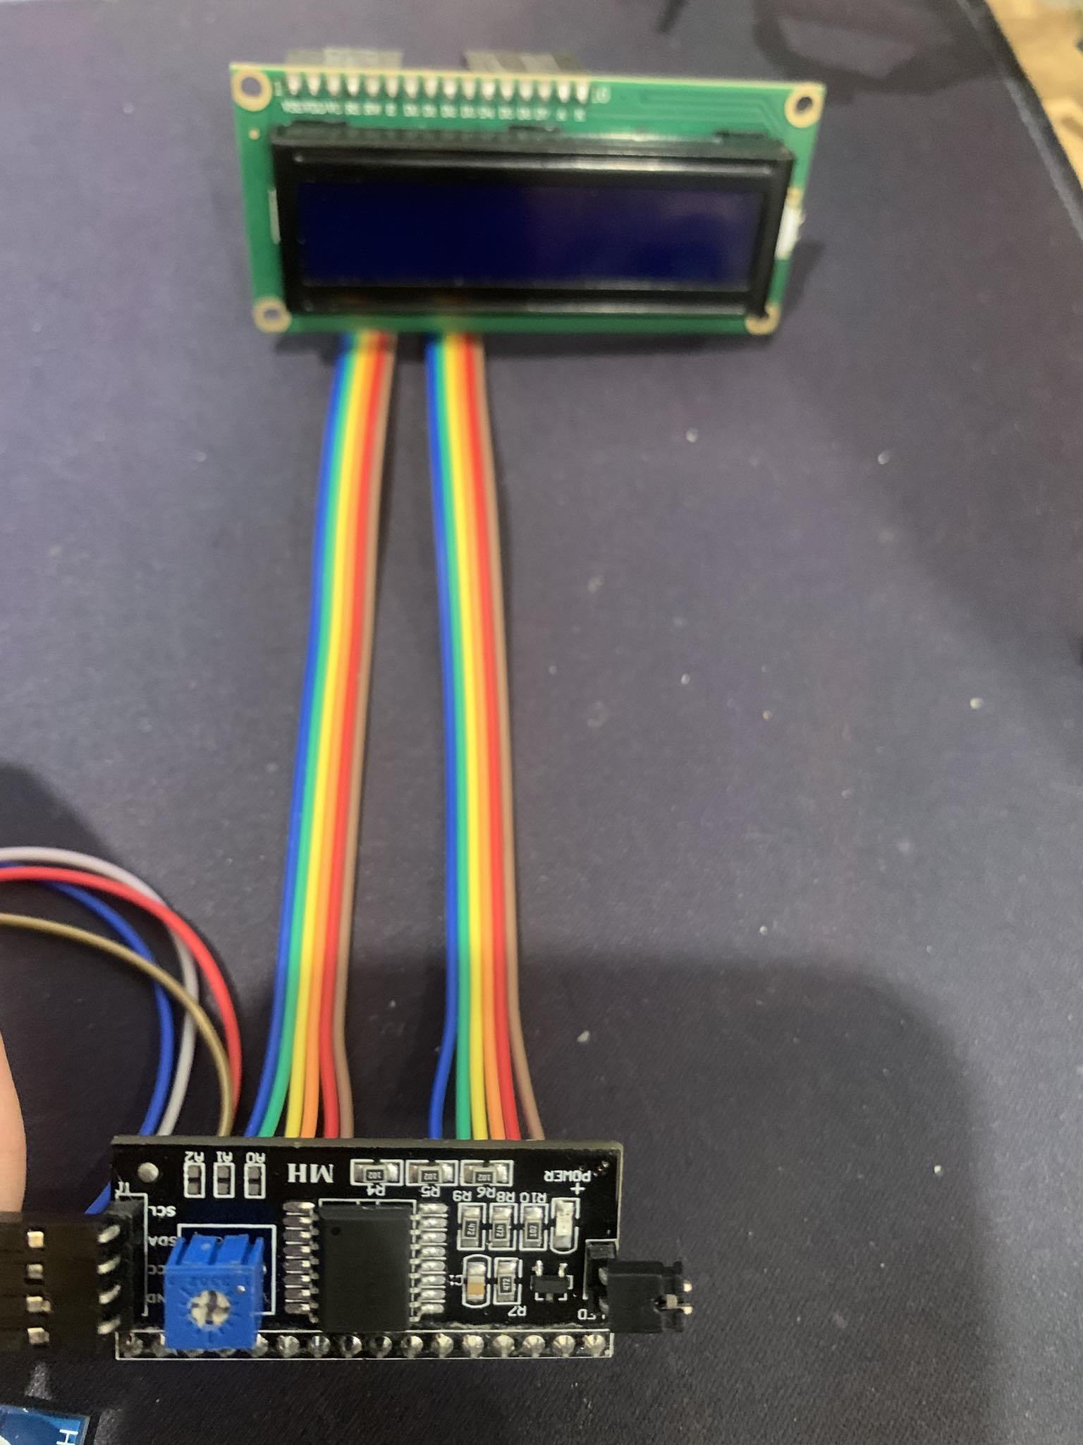
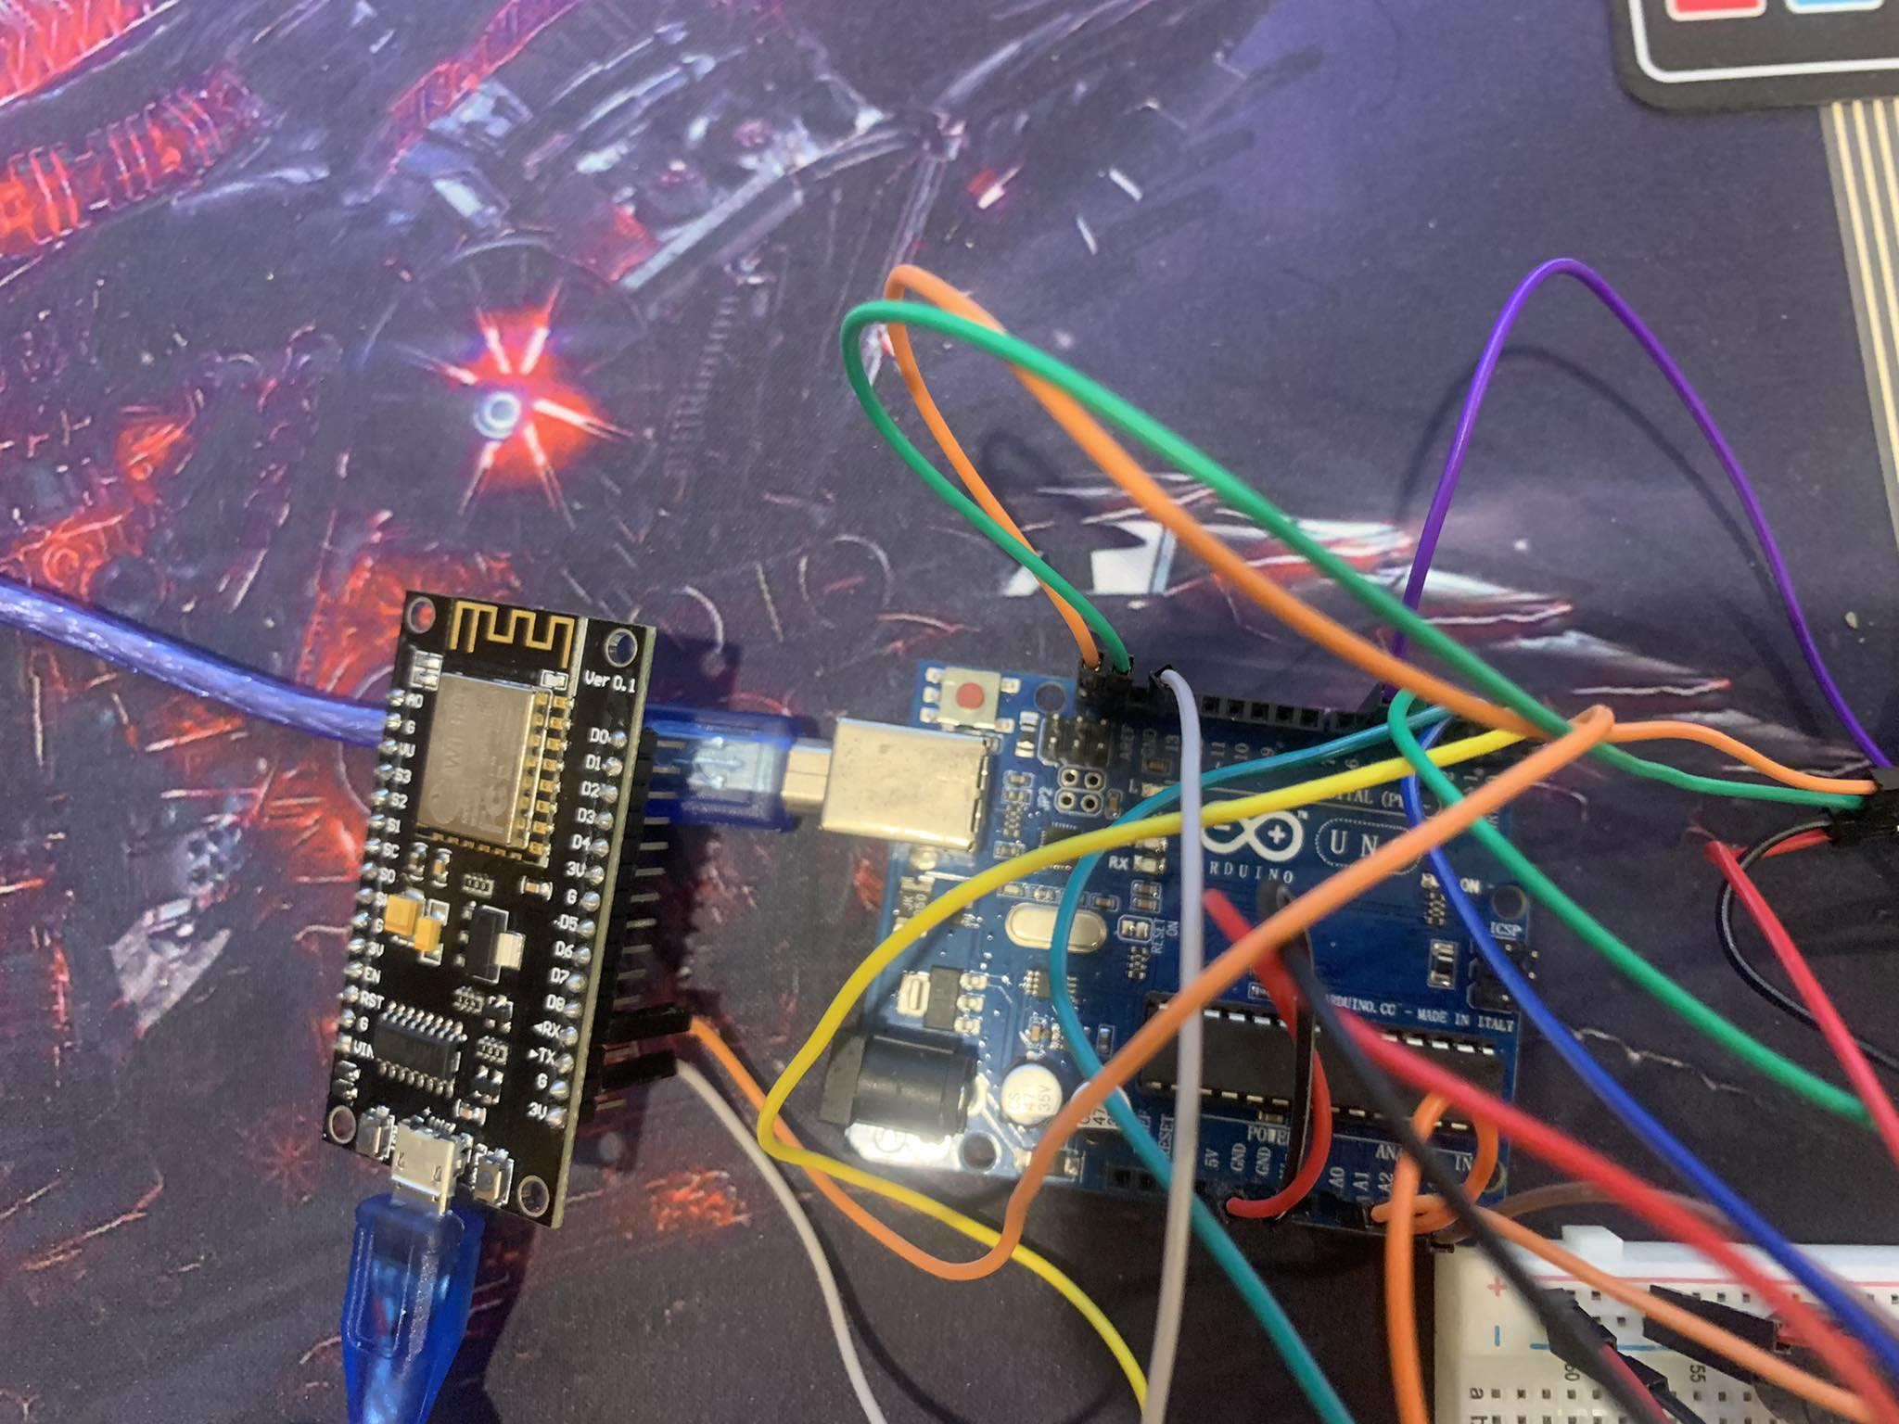
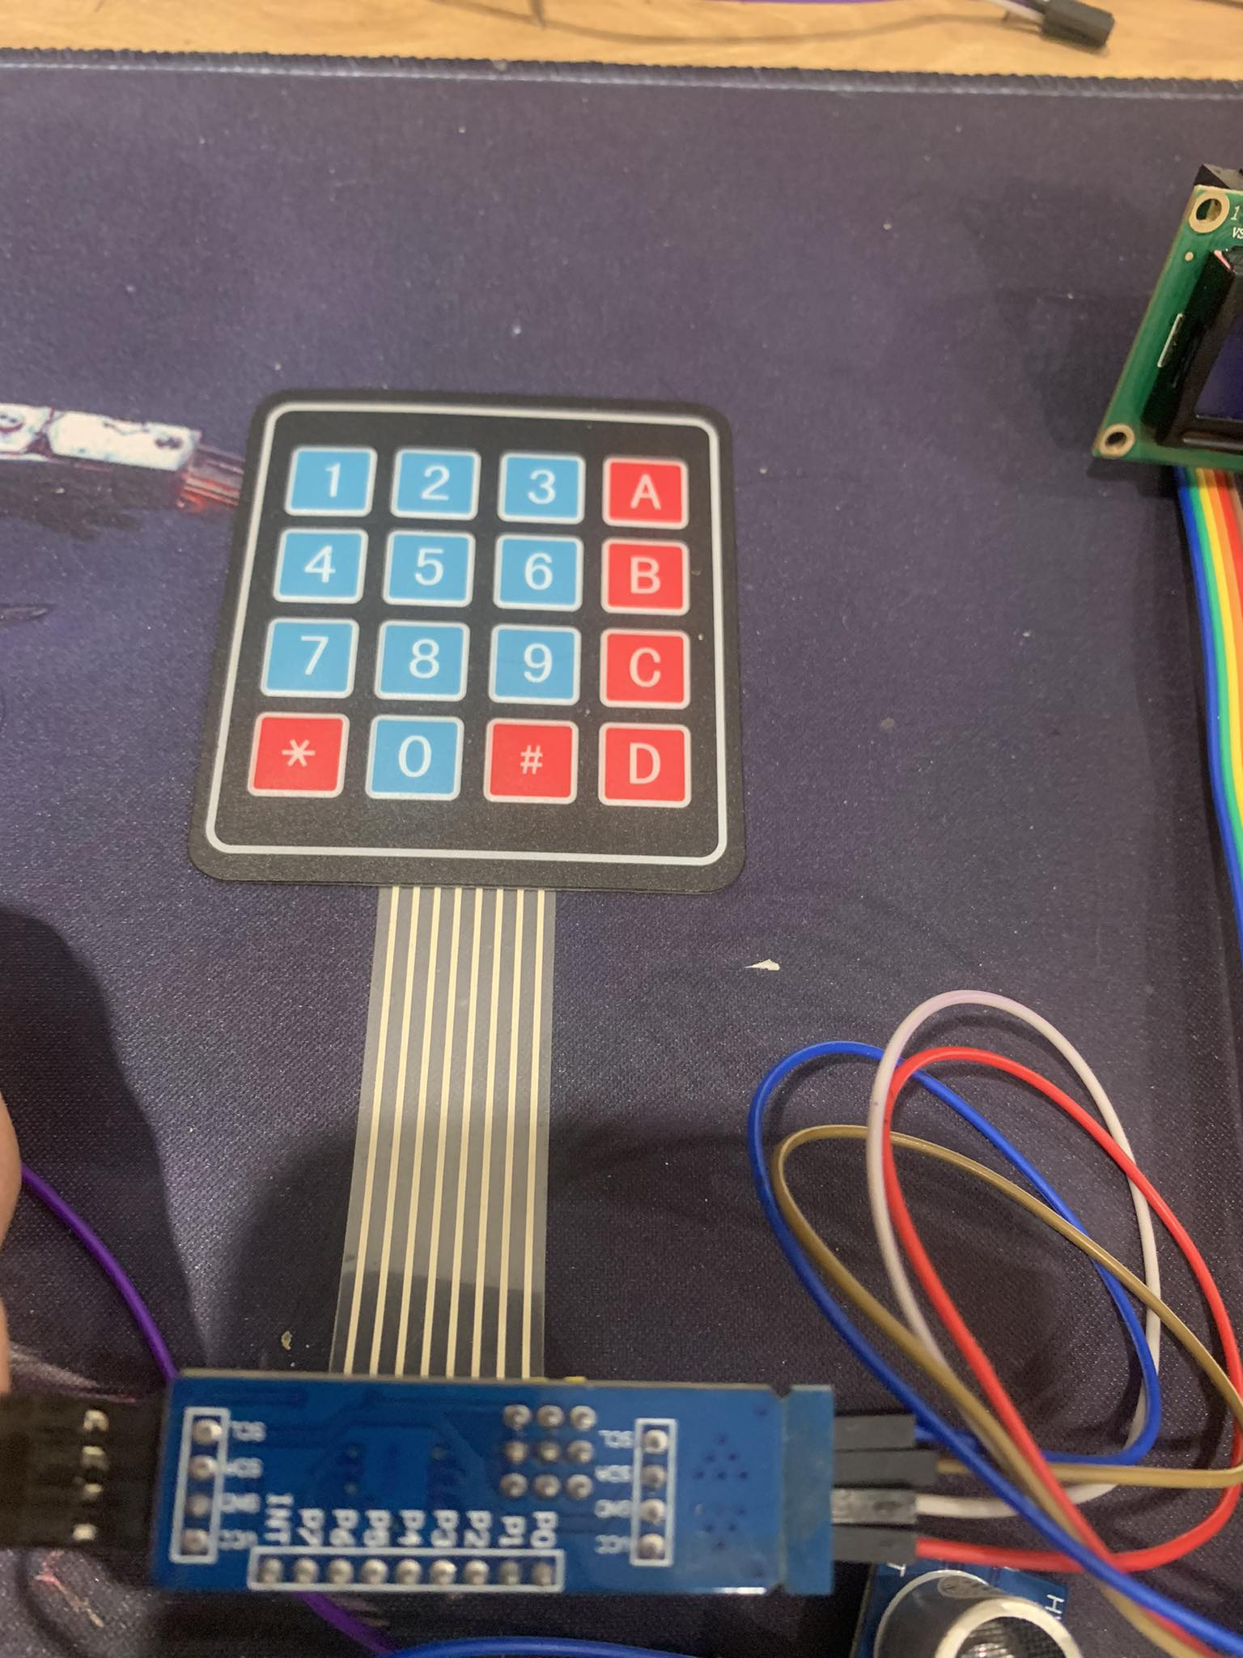
RESULT AND DISCUSSION

Slide 22
CONCLUSION
5

Slide 23
CONCLUSION
To deal with the thief problems increasing day by day, the Lock Door System is developed. It compeletely remove standard lock with the keys. Instead of this, the Lock Door System use a Card with the RFID Module to open the door, or opening the door with a password by Keypad or on our phone with Bluetooth. It’s much more convenient and extremely security. It can open the door when you in home with 1 click the button. Overall, it is almost complety project and a good starting point for implement it in the real life. Keep in mind that the hardware and software being used will determine the precise implementation details, and extra precautions could be needed to guarantee the system's security.

Slide 24
THANKS FOR WATCHING

